Slide 1
Modeling of Detrapping electron in BE-TOX by Elastic Tunneling Emission 20241129 진명

Slide 2
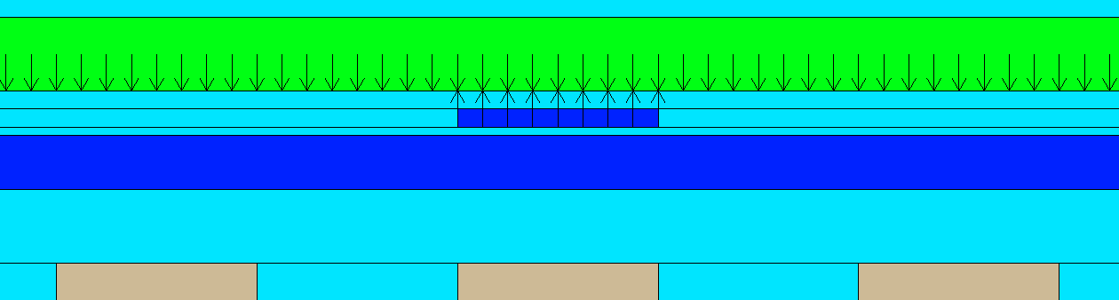
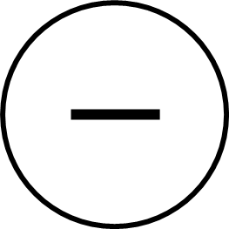
NonLocal Tunneling in TCAD
Channel
Nonlocal mesh
: interface – mesh(trap) coupling
CTN
WL
WL
WL
BE-TOX (ONO)
Coupled trap – interface 관계가 SRH theory와 같은 steady state 상태에서 이루어짐
+
Nonlocal tunneling = Elastic + phonon-assisted
CTN
ox1 layer
ox2 layer
n1 layer
Interface – trap coupling

Slide 3




Elastic Tunneling Capture & Emission
$c_{n, elastic}=\frac{2π}{ℏ} {\left|E_{T}\right|}^{2} V_{T} ∙\frac{\sqrt{2}}{π^{2}ℏ^{3}} \sqrt{m_{⊥}^{∗}} m_{0∥} \sqrt{E_{trap}−E_{c0}}\frac{1}{1+\exp\left(\frac{E_{trap}−E_{Fi}}{kT}\right)} \left|TC\right|$
$e_{n, elastic}=\frac{2π}{ℏ} {\left|E_{T}\right|}^{2} V_{T} ∙\frac{\sqrt{2}}{π^{2}ℏ^{3}} \sqrt{m_{⊥}^{∗}} m_{0∥} \sqrt{E_{trap}−E_{c0}}\frac{1}{\exp\left(−\frac{E_{trap}−E_{Fi}}{kT}\right)+1} \left|TC\right|$
BE-TOX (ONO)
CTN
ox1 layer
ox2 layer
Since E_{trap}>> E_{Fi} , emission >> capture
Trap – to – Band emission occurs
n1 layer
$e_{n, elastic}$
$c_{n, elastic}$
$E_{trap}$
$E_{Fi}$

Slide 4
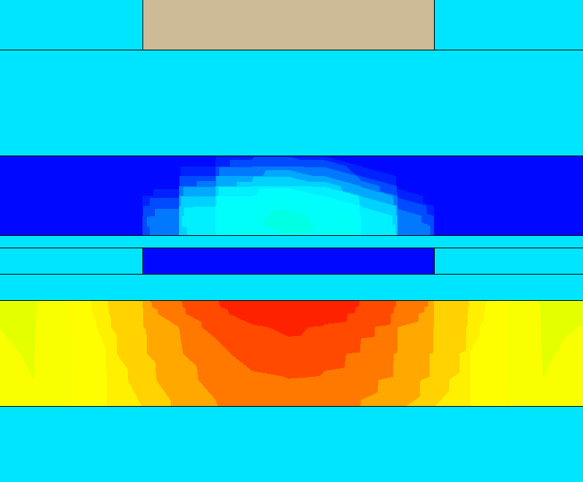
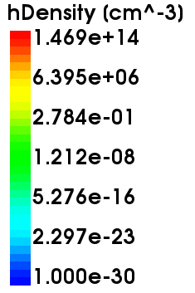
Channel Potential
CTN programmed electron forms negative voltage
>> hole accumulation at channel
Negative channel potential bias!
20V single pulse 1us program:
Vch = -1.9V
(Can be specified for certain PV level)
V_{ch}

Slide 5
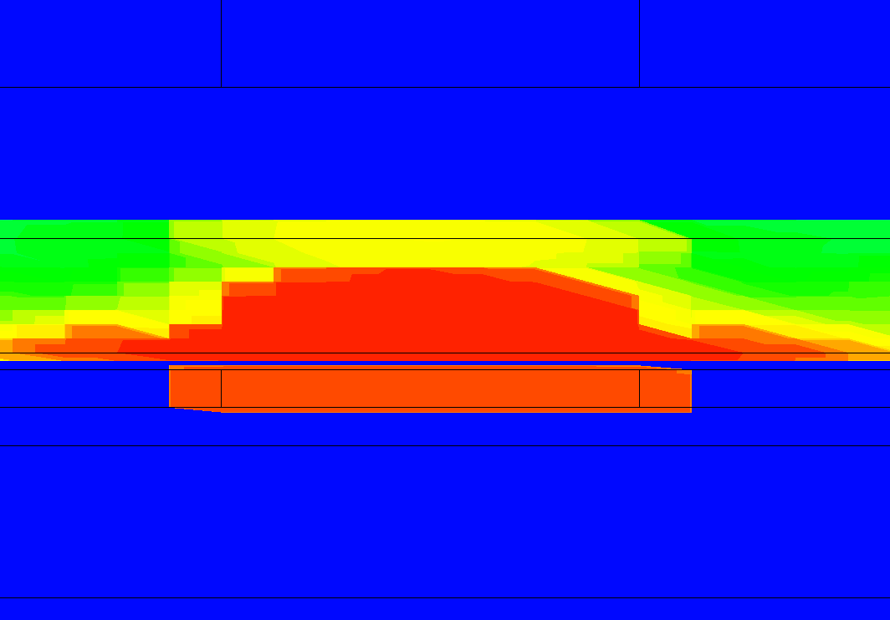
TCAD & Modeling Method
TCAD Setting
WL
Box
CTN CCS Nullification (~ 0)
> Ideal electron retention
CTN
BETOX oxide envelope
> No lateral spreading occurs
BE-TOX
Channel
Modeling Setting
BE-TOX
Modeling designed with vertical segments

Slide 6




Modeling Method of Coordinate Segment
BE-TOX (ONO)
BE-TOX
CTN
ox1 layer
ox2 layer
coordinate
n1 layer
$e_{n, elastic}$
Energy Band
$c_{n, elastic}$
$E_{trap}$
F_{n, j}
$E_{Fi}$
“Centered balance point”
F_{ox}
(r_{tox},center)
λ used as a fitting parameter
(0< λ<1)
1-λ
λ

Slide 7
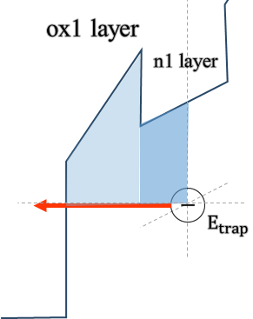
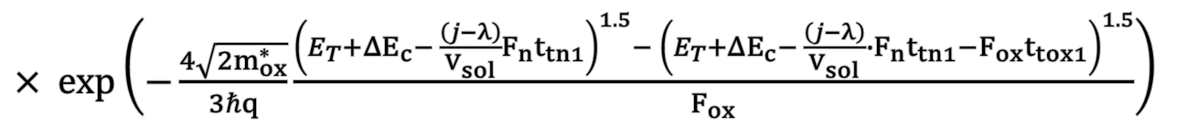
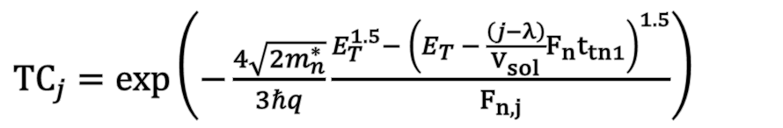
Transmission Coefficient
$c_{n, elastic}=\sum_{j}{\frac{2π}{ℏ} {\left|E_{T}\right|}^{2} V_{T} ∙\frac{\sqrt{2}}{π^{2}ℏ^{3}} \sqrt{m_{⊥}^{∗}} m_{0∥} \sqrt{E_{trap}−E_{c0}}\frac{1}{1+\exp\left(\frac{E_{trap}−E_{Fi}}{kT}\right)} \left|{TC}_{j}\right|}$
$e_{n, elastic}=\sum_{j}{\frac{2π}{ℏ} {\left|E_{T}\right|}^{2} V_{T} ∙\frac{\sqrt{2}}{π^{2}ℏ^{3}} \sqrt{m_{⊥}^{∗}} m_{0∥} \sqrt{E_{trap}−E_{c0}}\frac{1}{\exp\left(−\frac{E_{trap}−E_{Fi}}{kT}\right)+1} \left|{TC}_{j}\right|}$
j^{th} segment along total V_{sol} segments
②
①
$TC_{j}=\exp\left(−\frac{4\sqrt{2m_{n}^{∗}}}{3ℏq}\frac{E_{T}^{1.5}− {\left(E_{T} − \frac{\left(j−λ\right)}{V_{sol}}F_{n}t_{tn1}\right)}^{1.5}}{F_{n, j}}\right)$
①
$× \exp\left(−\frac{4\sqrt{2m_{ox}^{∗}}}{3ℏq}\frac{{\left(E_{T}+ΔE_{c}− \frac{\left(j−λ\right)}{V_{sol}}F_{n}t_{tn1}\right)}^{1.5}− {\left(E_{T}+ΔE_{c}− \frac{\left(j−λ\right)}{V_{sol}}∙F_{n}t_{tn1}−F_{ox}t_{tox1}\right)}^{1.5}}{F_{ox}}\right)$
②

Slide 8
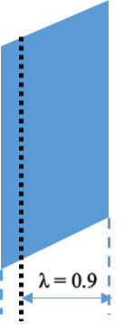
Result of Elastic Tunneling Model
Result and comparison with TCAD simulation
0.6 eV Elastic
0.8 eV Elastic
1.5 eV Elastic
Sharing parameter : λ = 0.9
V_{sol} = 7
λ = 1
λ = 0
Location
correction
: total 7 segments

Slide 9
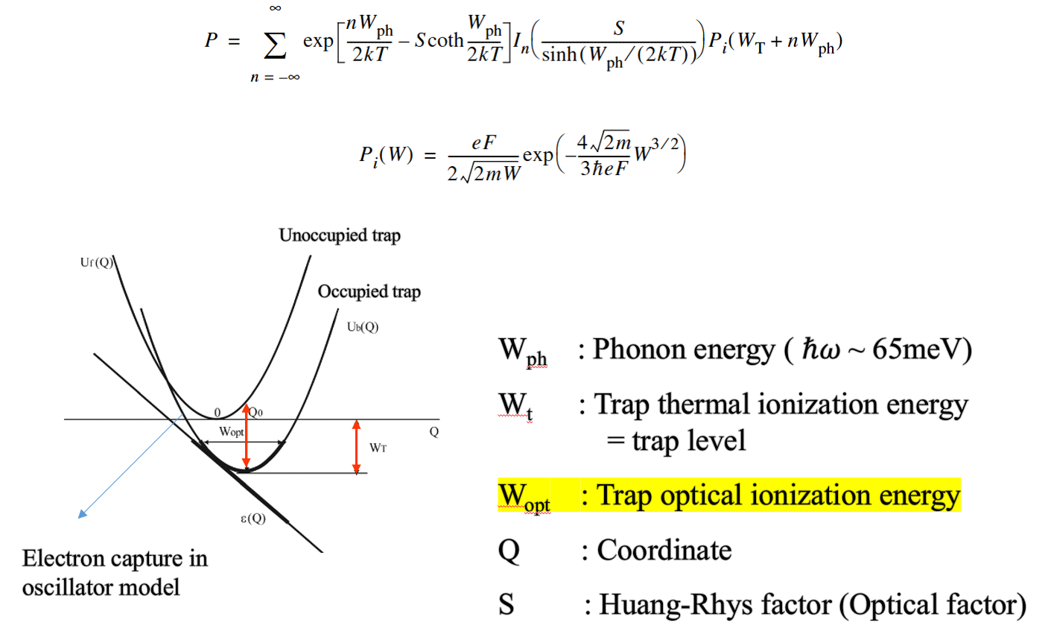
Phonon-assisted Model
1.5 eV Elastic
Detrap이 끝나갈 쯤, TCAD에서는 detrap 가속화
>> Phonon-assisted

Slide 10
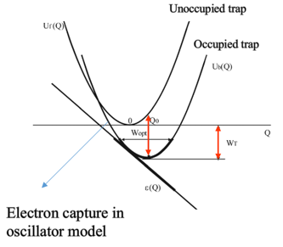
Phonon-assisted Model Result
1.5 eV Elastic
1.5 eV Phonon-assisted
Because…
Phonon-assisted
elastic
Detrapping over time
앞부분 부터 elastic으로 빠짐
남아있는 뒷부분은 Phonon-assisted
Elastic 과 거의 차이 없음
0.6 eV Phonon-assisted
0.8 eV Phonon-assisted
W_{ph} = 0.06 eV
W_{t} = Et
W_{opt} fitting result in 2nd order
W_{opt} = E_{t} + (E_{t}+0.2)²

Slide 11
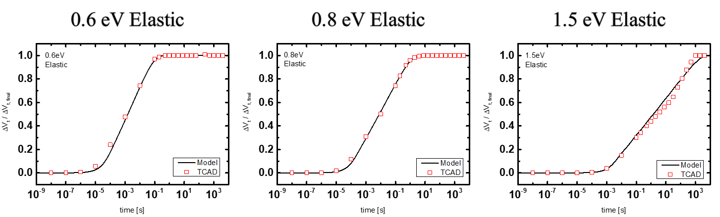
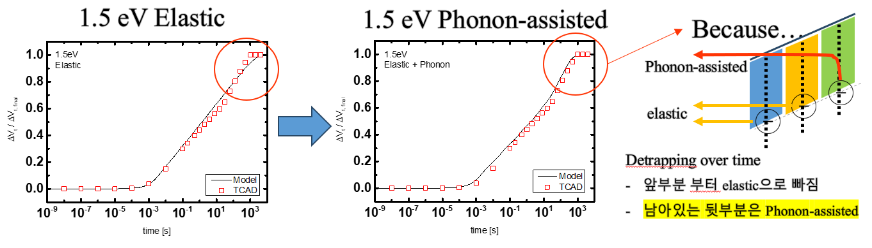
Summary
$e_{n, elastic}=\frac{2π}{ℏ} {\left|E_{T}\right|}^{2} V_{T} ∙\frac{\sqrt{2}}{π^{2}ℏ^{3}} \sqrt{m_{⊥}^{∗}} m_{0∥} \sqrt{E_{trap}−E_{c0}}\frac{1}{\exp\left(−\frac{E_{trap}−E_{Fi}}{kT}\right)+1} \left|TC\right|$
: Trap-to-Band elastic tunneling emission rate
Elastic Tunneling TCAD Fitting
Phonon-assisted correction in deep trap

Slide 12
Appendix Elastic Tunneling Interface-Trap coupling

Slide 13
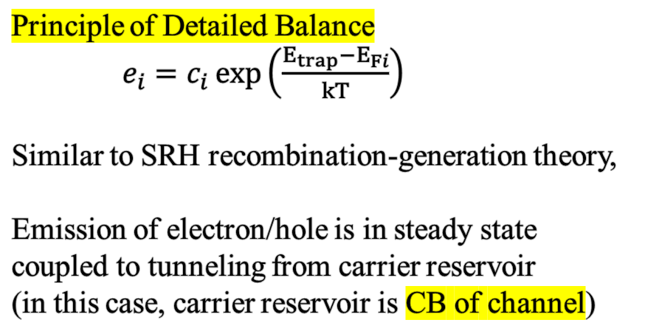




Interface-Trap Coupling by Elastic Tunneling
BE-TOX (ONO)
Principle of Detailed Balance
$e_{i}=c_{i}\exp\left(\frac{E_{trap}−E_{Fi}}{kT}\right)$
Similar to SRH recombination-generation theory,
Emission of electron/hole is in steady state coupled to tunneling from carrier reservoir
(in this case, carrier reservoir is CB of channel)
CTN
ox1 layer
ox2 layer
n1 layer
$e_{n, elastic}$
$c_{n, elastic}$
$E_{Fi}$
$c_{n, elastic}=D\left(E_{trap}\right)∙W_{transition}∙f_{c}\left(E_{trap}\right)∙\left|TC\right|$
$e_{n, elastic}=c_{n, elastic}\exp\left(\frac{E_{trap}−E_{Fi}}{kT}\right)$

Slide 14



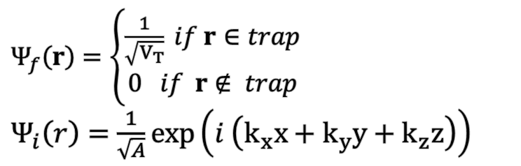
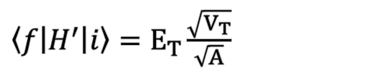
Capture Rate by Elastic Transition
$c_{n, elastic}=D\left(E_{trap}\right)∙W_{transition}∙f_{c}\left(E_{trap}\right)∙\left|TC\right|$
$W_{transition}=\frac{2π}{ℏ} {\left|\left\langle f | H^{′} | i\right\rangle \right|}^{2} δ\left(E−E_{T}\right)$ : Transition rate by Fermi golden rule
$H^{′}= \left\{\begin{aligned}0 \\ −E_{T}\end{aligned} \right.$ : Constant perturbation of energy band by trap
$Ψ_{f}\left(r\right)=\left\{\begin{aligned}\frac{1}{\sqrt{V_{T}}} if r∈trap \\ 0 if r∉ trap\end{aligned}\right.$
$Ψ_{i}\left(r\right)=\frac{1}{\sqrt{A}}\exp\left(i \left(k_{x}x+k_{y}y+k_{z}z\right)\right)$
Constant Trap
$\left(H_{B}+H^{′}\right)ψ=E_{c} ψ$ : Unperturbed energy band free electron
$E_{c}$
$E_{t}$
Free wave eq.
$\left\langle f | H^{′} | i\right\rangle =E_{T}\frac{\sqrt{V_{T}}}{\sqrt{A}}$
$\left(H_{B}+H^{′}\right)ψ=\left(E_{c}−E_{t}\right)ψ$ : Trapped electron
$W_{transition}=\frac{2π}{ℏ} V_{T} E_{T}^{2} δ\left(E−E_{T}\right)$

Slide 15
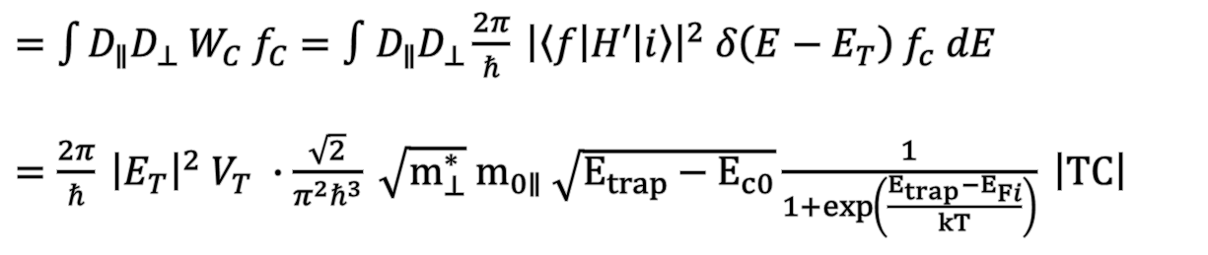
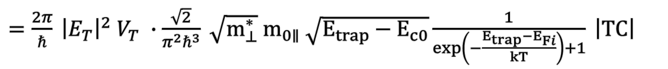
Capture/Emission of Nonlocal Tunneling
$c_{n, elastic}=D\left(E_{trap}\right)∙W_{transition}∙f_{c}\left(E_{trap}\right)∙\left|TC\right|$
$=\int{D_{∥}D_{⊥} W_{C} f_{C}}=∫D_{∥}D_{⊥}\frac{2π}{ℏ} {\left|\left\langle f | H′ | i\right\rangle \right|}^{2} δ\left(E−E_{T}\right) f_{c} dE$
$=\frac{2π}{ℏ} {\left|E_{T}\right|}^{2} V_{T} ∙\frac{\sqrt{2}}{π^{2}ℏ^{3}} \sqrt{m_{⊥}^{∗}} m_{0∥} \sqrt{E_{trap}−E_{c0}}\frac{1}{1+\exp\left(\frac{E_{trap}−E_{Fi}}{kT}\right)} \left|TC\right|$
$e_{n, elastic}=c_{n, elastic}\exp\left(\frac{E_{trap}−E_{Fi}}{kT}\right)$
$=\frac{2π}{ℏ} {\left|E_{T}\right|}^{2} V_{T} ∙\frac{\sqrt{2}}{π^{2}ℏ^{3}} \sqrt{m_{⊥}^{∗}} m_{0∥} \sqrt{E_{trap}−E_{c0}}\frac{1}{\exp\left(−\frac{E_{trap}−E_{Fi}}{kT}\right)+1} \left|TC\right|$

